Slide 1
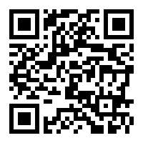
Regression Methods Online Instruction
LECTURE 14/April 28, 2020
Please mute yourself after joining. Unmute when you wish to speak.
This session is being recorded. Chat messages will be saved. Session will be posted in Canvas.
Last week:
Chapter 10 Time series modeling and forecasting
Moving average, exponential smoothing, Holt-Winters, (8.7) Detecting Residual Correlation, Durbin-Watson test, Regression approach to forecasting
Tonight
Study guide, textbook material to review, list of lecture documents to review
HW 6-14 solutions
All Lecture material to review is in Canvas under Files:
Answer your questions
Student Instructional Rating Survey opened through May 7. Please complete – your feedback is important.
https://sirs.ctaar.rutgers.edu/blue QR code
Index | Section | Exam Code | Exam Day and Time
29880 | 01 | S | Tuesday, May 12, 2020: 8:00 PM - 11:00 PM

